Slide 1



The Santiago Longitudinal Cohort Study: Genetic Predisposition to Cardiometabolic Risk.
Kari E. North, Ann Von Holle, Anne Justice, and Misa Graff
Department of Epidemiology
Carolina Center for Genome Sciences
University of North Carolina
Chapel Hill, NC 27587
kari_north@unc.edu
December 14, 2016

Slide 2
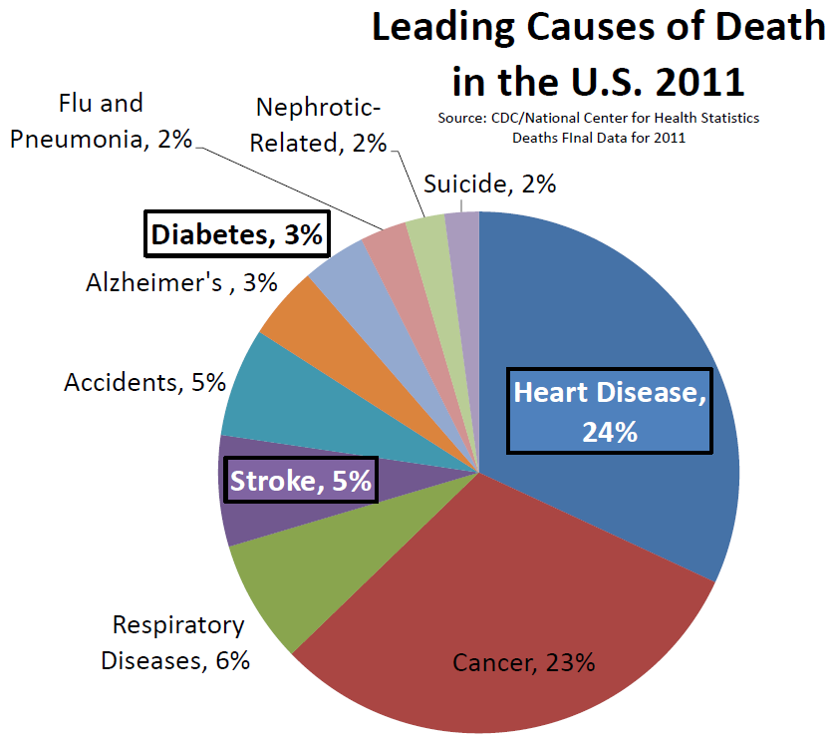
Cardiometabolic Risk: Pathways to Disease
Cardiometabolic Risk
The chances of having heart disease, stroke, and diabetes.
Top ten leading causes of death in the U.S. and in much of the world.
Obesity
Second only to smoking as a leading cause of preventable death.
Notes:
My primary research focus within genetic epidemiology is on cardiometabolic risk, which refers to the chances of having heart disease, stroke, and diabetes.
All three of these are among the top ten leading causes of death in the U.S. and in much of the world.
Obesity is a major risk factor for all three, second only to smoking a leading causes of preventable death.
So, much of my research focuses on obesity
Additionally, obesity is linked to more than 30 other diseases including many types of cancer, respiratory diseases, such as COPD and asthma, sleep apnea, incontinence, gallstone disease, birth defects, and suicide.

Slide 3
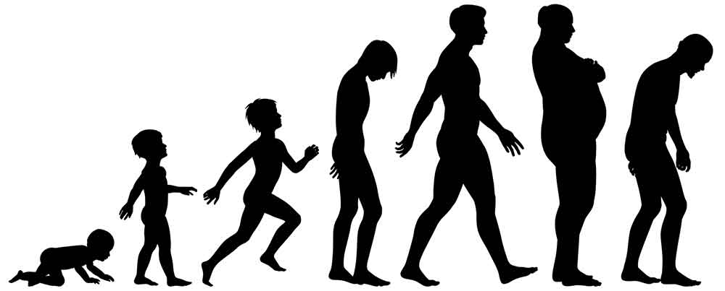

Uterine Environment, Diet, Physical Activity, SES
Genetic Association Studies
Weight and Adiposity Changes
Genetic Sequence Variation
Cardiometabolic Disease
High blood sugar
High cholesterol
High blood pressure
Hispanics and especially Latin Americans are at high risk for cardiometabolic disease, with rapid expansion of obesity in the context of accelerating urbanization.
Notes:
Obesity is one of the leading risk factors for cardiovascular disease (CVD) in the world today. Hispanics and especially Latin Americans are at high risk, with rapid expansion of obesity and CVD in the context of accelerating urbanization. Furthermore, HL populations transition from normal weight to obesity at younger ages than age-matched members of other race-ethnic groups. Yet we know little about how genetic variants influence these temporal changes in obesity and downstream CVD risk factors across the lifecourse. This research takes place in Chile, where dramatic socioeconomic improvement accompanied by changes in diet, activity and environment, resulted in obesity prevalence among the highest in the world. As such, our aims were to: 1) evaluate the influence of established obesity variants on adiposity from infancy to young adulthood, and 2) evaluate the influence of established obesity variants on CVD risk in adolescence and young adulthood. This research takes place within the Santiago Longitudinal Study (SLS), a longitudinal cohort study of over 1100 young adults recruited at 6 months old between 1991 and 1996 with anthropometric and cardiovascular risk data collected at multiple time points.

Slide 4
Age-related Weight and Adiposity Changes
Genetic Sequence Variation
Genetic Sequence Variation
Genetic Sequence Variation
Cardiometabolic Disease
High blood sugar
High cholesterol
High blood pressure
How do genetic variants influence obesity and other CMD risk factors and temporal changes in these risk factors across the lifecourse?
Notes:
Obesity is one of the leading risk factors for cardiovascular disease (CVD) in the world today. Hispanics and especially Latin Americans are at high risk, with rapid expansion of obesity and CVD in the context of accelerating urbanization. Furthermore, HL populations transition from normal weight to obesity at younger ages than age-matched members of other race-ethnic groups. Yet we know little about how genetic variants influence these temporal changes in obesity and downstream CVD risk factors across the lifecourse. This research takes place in Chile, where dramatic socioeconomic improvement accompanied by changes in diet, activity and environment, resulted in obesity prevalence among the highest in the world. As such, our aims were to: 1) evaluate the influence of established obesity variants on adiposity from infancy to young adulthood, and 2) evaluate the influence of established obesity variants on CVD risk in adolescence and young adulthood. This research takes place within the Santiago Longitudinal Study (SLS), a longitudinal cohort study of over 1100 young adults recruited at 6 months old between 1991 and 1996 with anthropometric and cardiovascular risk data collected at multiple time points.

Slide 5

What is a Complex Trait?
Genes
Environments

Slide 6

Why study genetic factors associated with disease?
Learn about biological mechanism, pathways, interactions
Diagnosis and treatment of genetic disorders
Better Understand Environment and Exposures
Prediction of drug response
Identify genetic risk to inform prevention strategies

Slide 7
MEGA (Multi-Ethnic Genotyping Array, Consortium) Maximum Sample size after QC = 881
Notes:
10 years into GWAS, what can we do differently?
Design chips that are more broadly applicable
Covering many populations
Multiple phenotypes, studies, biobanks
Leverage current sequencing initiatives
Incorporate existing findings and local LD patterns
Transethnic conclusions and better causal variant inference

Slide 8
Do Lipid Related Genetic Effects Generalize to Adolescents in Chile?

Slide 9
What do we know about the genetics of lipid related traits?
Lipid related traits are highly heritable
Lipid traits are heritable (h² can exceed 0.50) (Goode et al. 2007) and strongly associated with cardiovascular disease sustaining strong interest in genetic research.
By 2013, researchers have identified more than 150 established loci influencing lipid levels in adults (C. J. Willer et al. 2013).

Slide 10
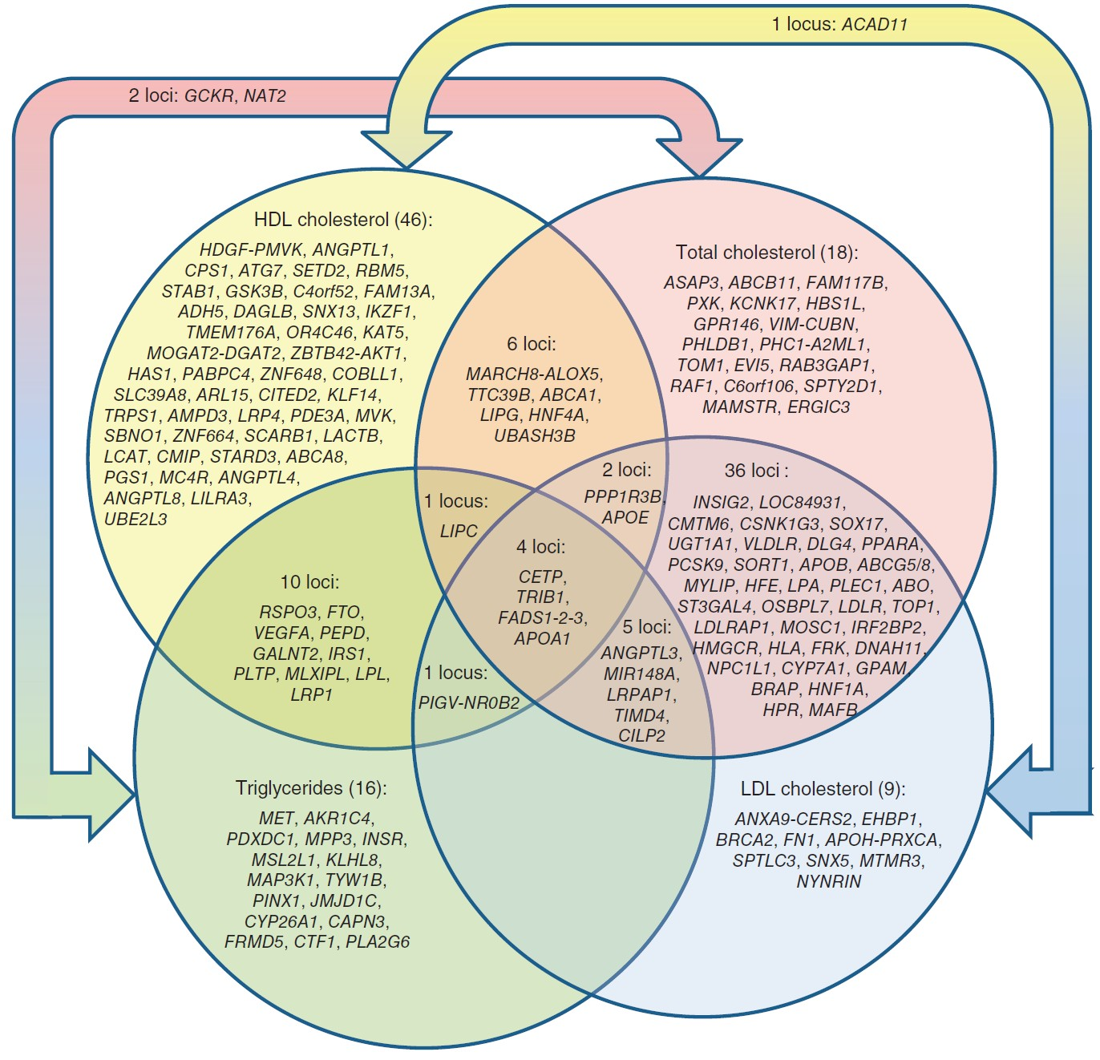
Global Lipids Known Genetic Loci
Source: Willer, C. J., Schmidt, E. M., Sengupta, S., Peloso, G. M., Gustafsson, S., Kanoni, S., Abecasis, G. R. (2013). Discovery and refinement of loci associated with lipid levels. Nature Genetics, 45(11), 1274–1283. https://doi.org/10.1038/ng.2797

Slide 11
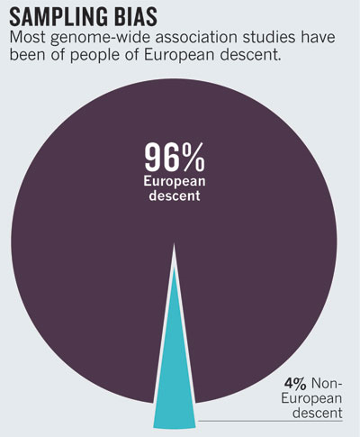

Genomics for the World?
Report considered GWAS as of 2009
The Landscape is slowly changing with expansion to Asian and African- American Consortium
New kid on the block, Hispanics
Bustamante C et al., 2011 Nature.

Slide 12
Genomics is failing on diversity. Popejoy AB, Fullerton SM. Nature. 2016 Oct 12;538(7624):161-164.
doi: 10.1038/538161a. No abstract available. PMID: 27734877

Slide 13
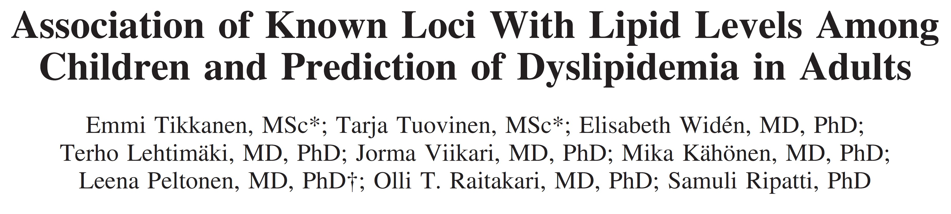
Generalizability across the lifecourse and ancestral groups
Results found for adults have been found to generalize to children in a Finnish population (Tikkanen et al. 2011; Buscot et al. 2016).
No studies in ancestrally diverse children.
The Combined Effect of Common Genetic Risk Variants on Circulating Lipoproteins Is Evident in Childhood: A Longitudinal Analysis of the Cardiovascular Risk in Young Finns Study
Marie-jeanne Buscot , Costan G. Magnussen, Markus Juonala, Niina Pitkänen, Terho Lehtimäki, Jorma S. A. Viikari, Mika Kähönen, Nina Hutri-Kähönen, Nicholas J. Schork, Olli T. Raitakari , Russell J. Thomson
Published: January 5, 2016 http://dx.doi.org/10.1371/journal.pone.0146081

Slide 14
Generalizability across the lifecourse and ancestral groups
Certain variants that associate with a trait such as dyslipdemia in one ancestral group may not associate in other groups (Carlson et al. 2013).
Why? Differences across ancestral groups include:
Variant frequencies
Linkage disequilibrium

Slide 15
What is Linkage Disequilibrium?
Maternal Chromosome
Paternal Chromosome
SNP 1:
T
A
What we actually want to detect the effect of:
The “high-risk” variant of the disease gene, which is here!
SNP 2:
C
G
SNP 3:
A
C
Linkage Disequilibrium (LD) describes the tendency of alleles to be inherited together more often than would be expected under random segregation.
SNP 4:
G
T
The closer together that 2 loci are, the less likely a recombination event will occur between them and they tend to “stick” together through generations.
→ We can take advantage of this information to find genes.

Slide 16
Do Lipid Related Genetic Effects Generalize to Adolescents in Chile?

Slide 17
Methods
Single Variant Association tests
We assessed single variant associations using linear regression for high density lipoprotein cholesterol (HDL- C), low density lipoprotein cholesterol (LDL-C) and triglycerides (TG), assuming an additive genetic model, adjusted for sex and ancestry (via principal components).
Polygenic risk scores
Regress phenotypes onto weighted trait-specific polygenic risk scores (PRS).
PRS for HDL-C
(0.48 * rs4660293 + 0.49 * rs2814944 + 0.59 * rs4731702 + 0.41 * rs2923084 + 0.4 * rs7134375 + 0.44 * rs7134594 + 1.45 * rs1532085 + 3.39 * rs3764261 + 0.45 * rs2925979 + 0.42 * rs4148008 + 0.39 * rs4129767 + 0.64 * rs737337 +1.88 * rs1800961 + 0.93 * rs6065906 + 0.47 * rs1689800 + 0.61 * rs4846914 + 0.68 * rs12328675 + 0.46 * rs2972146+ 0.49 * rs6450176 + 0.39 * rs605066 + 1.95 * rs1084651 + 1.21 * rs9987289 + 0.44 * rs2293889 + 0.65 * rs581080 + 0.94 * rs1883025 + 0.78 * rs3136441 + 0.86 * rs4759375 + 0.44 * rs4765127 + 0.61 * rs838880 + 0.39 * rs2652834 +1.27 * rs16942887 + 0.48 * rs11869286 + 1.31 * rs7241918 + 0.42 * rs12967135 + 0.45 * rs7255436 + 0.83 * rs386000
+ 0.46 * rs181362 + 0.84 * rs13107325) / 29.79
All PRS are standardized in the regression models: regression coefficient for PRS indicates a one unit change in SD of PRS.

Slide 18
Results
Descriptive statistics
Descriptive statistics by gender, median (interquartile range)
 | Female |  | Male
Trait | (n=263) |  | (n=283)
log(TG (mmol/l)) | 1.44 (0.53) |  | 1.38 (0.6)
LDL-C (mmol/l) | 5.26 (1.55) |  | 5.02 (1.53)
HDL-C (mmol/l) | 2.3 (0.77) |  | 2.05 (0.66)
TC (mmol/l) | 8.55 (1.79) |  | 7.96 (1.65)
Age (years) | 16.77 (0.3) |  | 16.76 (0.31)
BMI (kg/m2) | 23.25 (5.33) |  | 22.31 (5.12)
Note: mmoll/ millimoles per litre; All subsequent references to TG refer to log(TG).

Slide 19
Results
Candidate single variant tests of association
Association between single variants and and serum lipid levels, additive model
rsid | Trait | Ref/Min allele | MAF | Effect (se) | p-value
rs1532085 | HDL-C | G/A | 0.33 | 0.053 (0.038) | 0.1655
rs3764261 | HDL-C | C/A | 0.31 | 0.158 (0.04) | 1e-04
rs6511720 | LDL-C | G/T | 0.07 | -0.013 (0.158) | 0.9318
rs1260326 | TG | C/T | 0.31 | 0.36 (0.15) | 0.0165
rs964184 | TG | C/G | 0.37 | 0.326 (0.148) | 0.0277
rs6511720 | TC | G/T | 0.07 | 0.125 (0.165) | 0.4481
For each significant variant, direction of effect matched the multiethnic adult GWAS from which SNPs were selected.

Slide 20
Weighted polygenic risk score (wPRS) regression coefficients
Results
Association between the genetic risk score and serum lipid levels, coefficient (SE)
Female Male
Outcome/trait | Not adjusted | Adjusted for BMI |  | Not adjusted | Adjusted for BMI
HDL | 0.13 (0.03) | 0.13 (0.03) |  | 0.14 (0.04) | 0.14 (0.04)
LDL | 0.16 (0.08) | 0.17 (0.08) |  | 0.23 (0.08) | 0.24 (0.08)
TG | 0.34 (0.15) | 0.08 (0.02) |  | 0.24 (0.13) | 0.05 (0.02)
All estimates significant at
level of 0.05 with the exception of TG levels for males.

Slide 21
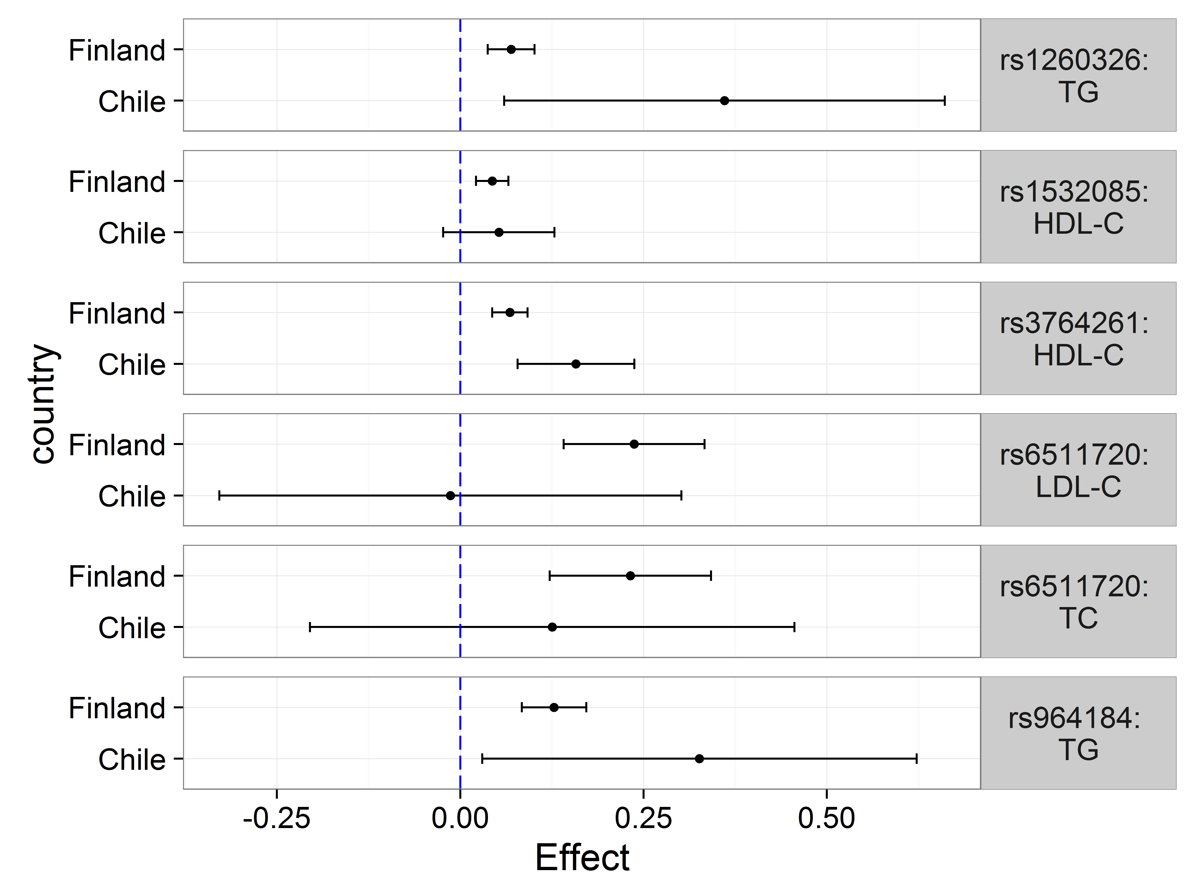
Results
Candidate single variant tests of association by variant and country
Note: Adjusted for sex of child and first five principal components representing ancestry.

Slide 22
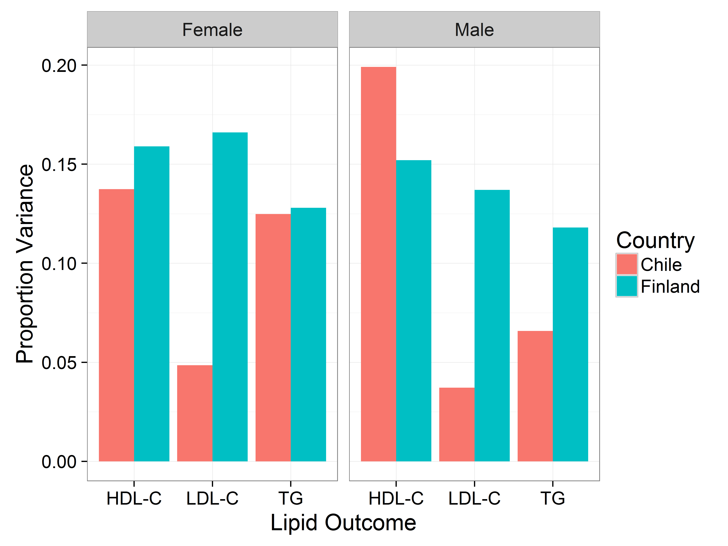
Results
Explained variance by gender and country

Slide 23
Summary
There is evidence that lipid loci from a Latino sample of adolescents contain similar associations as those from European children and adults.
Despite the small sample size and possibility for bias with different ancestral groups we found meaningful and statistically significant associations relating lipid loci in a HL cohort of Chilean adolescents with those found in European ancestral groups.
These associations emphasize the importance of adolescence as a time for disease prevention given studies demonstrating both the persistence of associations between PRS and lipids over the life course and the increasing role PRS plays in predicting disease.

Slide 24

What about Gene-Environment Interaction (Is Age Important)?

Slide 25
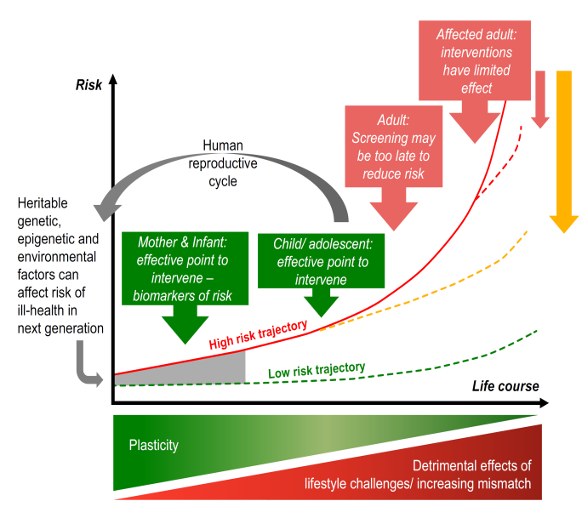
Developmental Origins of Health and Disease
¹ M. A. Hanson and P. D. Gluckman. “Early Developmental Conditioning of Later Health and Disease: Physiology or Pathophysiology?” In:Physiological Reviews 94.4 (Oct. 1, 2014), pp. 1027–1076. doi: 10.1152/physrev.00029.2013.

Slide 26
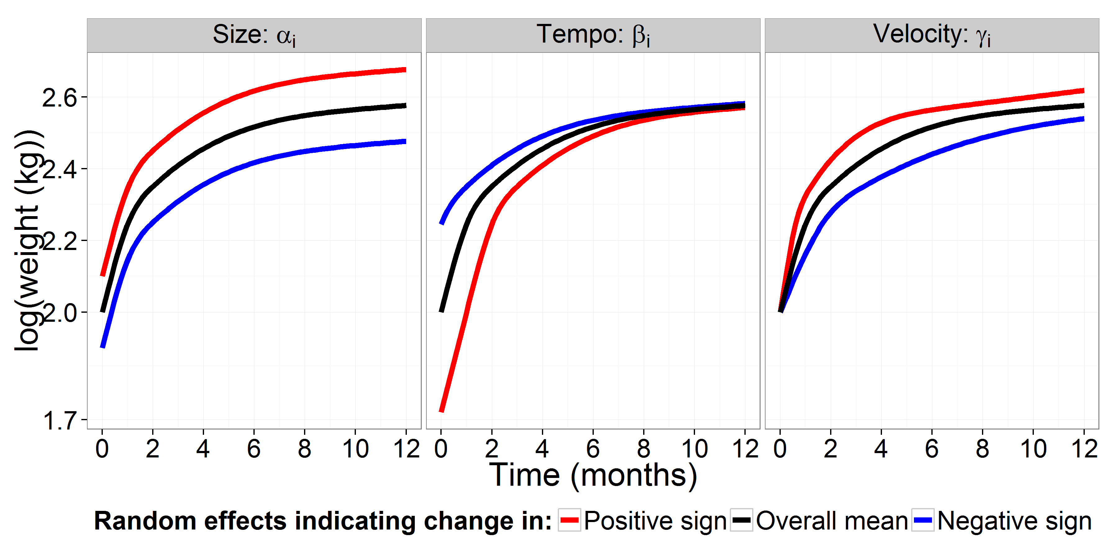
Modeling Growth and Development Across the Lifecourse: SITAR: Super Imposition by Translation And Rotation
K. J. Beath. “Infant growth modelling using a shape invariant model with random effects”. In: Statistics in Medicine 26.12 (May 30, 2007), pp. 2547–2564. doi: 10.1002/sim.2718; T. J. Cole et al. “SITAR–a useful instrument for growth curve analysis”. In: International Journal of Epidemiology 39.6 (July 20, 2010), pp. 1558–1566. doi: 10.1093/ije/dyq115.

Slide 27
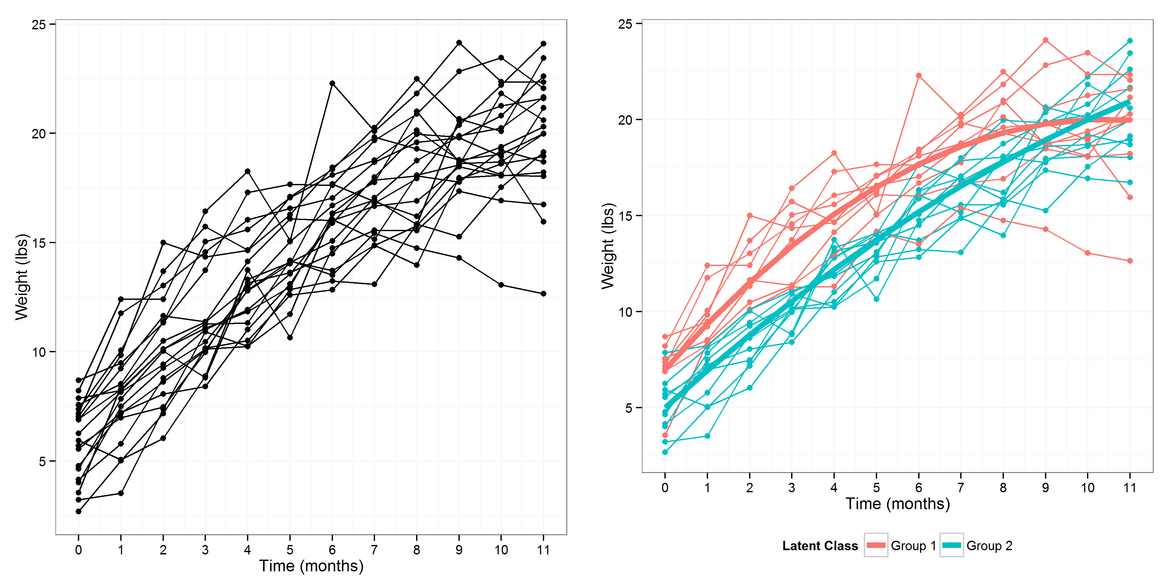
Modeling Growth and Development Across the Lifecourse: Latent Growth Mixture Modeling

Slide 28
Extra slides: Other work
AHA EPI/Lifestyle 2015 Poster: Childhood body mass index (BMI) z-scores associated with low HDL-C levels in adolescence in a Chilean cohort
UNC EPID 726 class presentation in advance of AHA predoctoral (successful) grant application (2016- 2018)
Questions about analyses? Please visit the github web page!
Assistance with slides by Ann Von Holle, doctoral student

Slide 29
Acknowledgements
Cardiovascular Genetic Epidemiology Laboratory
Affiliated Faculty: Gerardo Heiss, Christy Avery, Eric Whitsel, Kimon Divaris, Misa Graff, Kristin Young
Post-Doctoral Scientists: Anne Justice, Cary Agler, Heather Highland
Pre-Doctoral Fellows: Sachiko Yoneyama, Ann Von Holle, Shelly Ann Love, Victoria Buchanan
Programmers: Yujie Wang, Rebecca Rohde
IT: Dick Howard

